Slide 1
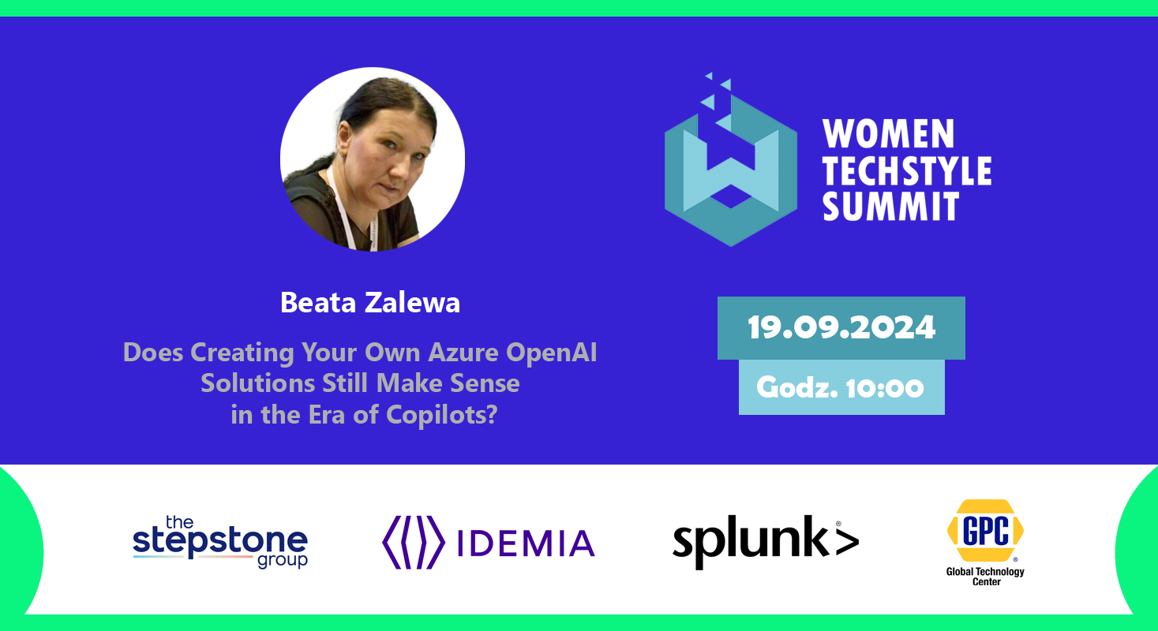
Notes:
In this presentation, we will explore the dangers of Social Engineering in Cyberattacks, and provide tips on how to avoid falling victim to this type of attack.

Slide 2

Agenda
Definition of Azure OpenAI
Introduction to Copilots
Challenges and Considerations
Q&A Session
Notes:
We will start by defining what Social Engineering is, and explore the common techniques used in Social Engineering attacks. Next, we will discuss how Social Engineering is used in Cyberattacks, and the impact it can have on individuals and organizations. Finally, we will provide tips on how to defend yourself against Social Engineering attacks.

Slide 3



Let’s go !
Notes:
Social Engineering is the art of manipulating people to divulge personal or confidential information. It is used in many types of Cyberattacks, and can have devastating consequences. In this section, we will explore the definition of Social Engineering, and the common techniques used in such attacks.

Slide 4

Let’s go !
Notes:
Social Engineering is the art of manipulating people to divulge personal or confidential information. It is used in many types of Cyberattacks, and can have devastating consequences. In this section, we will explore the definition of Social Engineering, and the common techniques used in such attacks.

Slide 5
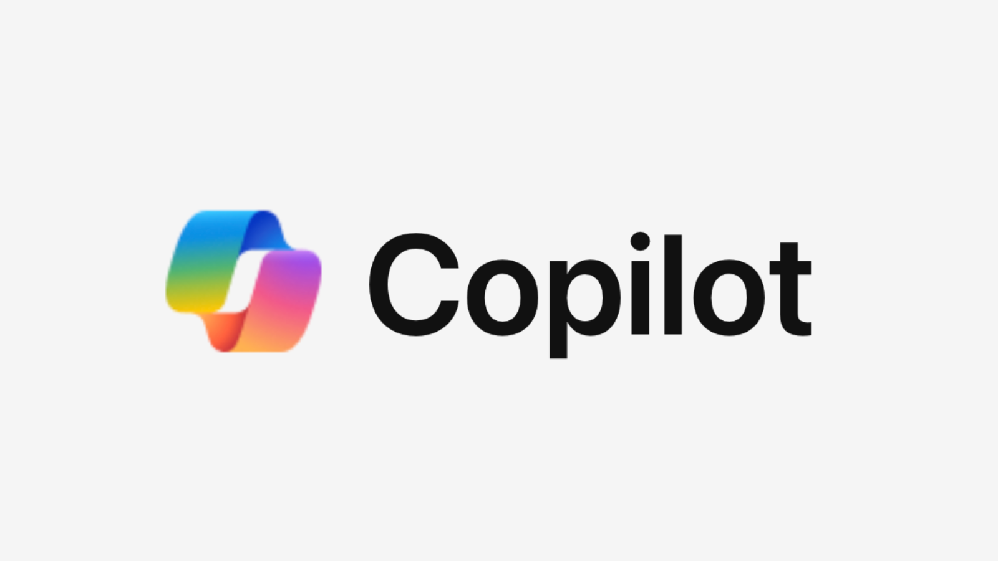
Introduction to Microsoft Copilots
Definition: Microsoft Copilots are AI-powered assistants designed to enhance productivity and streamline workflows.
Purpose: They assist users by automating repetitive tasks, providing intelligent suggestions, and integrating seamlessly with Microsoft 365 applications.
Impact: Copilots transform the way we work, making complex tasks simpler and more efficient.
Notes:
We will start by defining what Social Engineering is, and explore the common techniques used in Social Engineering attacks. Next, we will discuss how Social Engineering is used in Cyberattacks, and the impact it can have on individuals and organizations. Finally, we will provide tips on how to defend yourself against Social Engineering attacks.

Slide 6

Key Features of Microsoft Copilots
Contextual Understanding: Copilots understand the context of your work, providing relevant suggestions and insights.
Natural Language Processing: Communicate with Copilots using natural language, making interactions intuitive and user-friendly.
Integration: Copilots are integrated across Microsoft 365 apps, including Word, Excel, PowerPoint, and Teams.
Notes:
We will start by defining what Social Engineering is, and explore the common techniques used in Social Engineering attacks. Next, we will discuss how Social Engineering is used in Cyberattacks, and the impact it can have on individuals and organizations. Finally, we will provide tips on how to defend yourself against Social Engineering attacks.

Slide 7

Benefits of Using Microsoft Copilots
Increased Productivity: Automate routine tasks, allowing you to focus on more strategic work.
Enhanced Collaboration: Copilots facilitate better collaboration by providing real-time suggestions and insights during team interactions.
Data-Driven Decisions: Access to intelligent data analysis helps in making informed decisions quickly.
Notes:
We will start by defining what Social Engineering is, and explore the common techniques used in Social Engineering attacks. Next, we will discuss how Social Engineering is used in Cyberattacks, and the impact it can have on individuals and organizations. Finally, we will provide tips on how to defend yourself against Social Engineering attacks.

Slide 8

Real-World Applications of Microsoft Copilots
Document Creation: Copilots assist in drafting, editing, and formatting documents in Word.
Data Analysis: In Excel, Copilots help analyze data, create charts, and generate reports.
Presentation Design: Copilots in PowerPoint offer design suggestions, layout improvements, and content enhancements.
Notes:
We will start by defining what Social Engineering is, and explore the common techniques used in Social Engineering attacks. Next, we will discuss how Social Engineering is used in Cyberattacks, and the impact it can have on individuals and organizations. Finally, we will provide tips on how to defend yourself against Social Engineering attacks.

Slide 9

How Microsoft Copilots Enhance Teamwork
Meeting Summaries: Copilots in Teams can generate meeting summaries, highlight key points, and assign action items.
Task Management: They help track tasks, set reminders, and ensure deadlines are met.
Communication: Copilots improve communication by suggesting responses and providing relevant information during chats.
Notes:
We will start by defining what Social Engineering is, and explore the common techniques used in Social Engineering attacks. Next, we will discuss how Social Engineering is used in Cyberattacks, and the impact it can have on individuals and organizations. Finally, we will provide tips on how to defend yourself against Social Engineering attacks.

Slide 10
Future of Microsoft Copilots
Continuous Learning: Copilots are designed to learn and improve over time, becoming more accurate and helpful.
Expanded Capabilities: Future updates will bring more features, making Copilots even more versatile.
Broader Integration: Expect deeper integration with other Microsoft services and third-party applications.
Notes:
We will start by defining what Social Engineering is, and explore the common techniques used in Social Engineering attacks. Next, we will discuss how Social Engineering is used in Cyberattacks, and the impact it can have on individuals and organizations. Finally, we will provide tips on how to defend yourself against Social Engineering attacks.

Slide 11
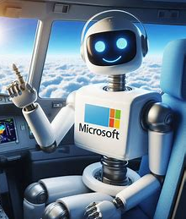
Getting Started with Microsoft Copilots
Access: Available to Microsoft 365 subscribers, Copilots can be accessed directly within the applications.
Training: Microsoft offers tutorials and resources to help users get the most out of Copilots.
Support: Dedicated support is available to assist with any issues or questions regarding Copilot usage.
Notes:
We will start by defining what Social Engineering is, and explore the common techniques used in Social Engineering attacks. Next, we will discuss how Social Engineering is used in Cyberattacks, and the impact it can have on individuals and organizations. Finally, we will provide tips on how to defend yourself against Social Engineering attacks.

Slide 12
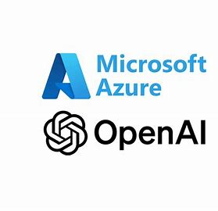
Introduction to Azure OpenAI
Azure OpenAI combines the power of OpenAI's models with Microsoft Azure's infrastructure.
Provides access to advanced AI capabilities, including natural language processing and computer vision.
Aims to simplify the development and deployment of AI solutions for businesses.
Notes:
We will start by defining what Social Engineering is, and explore the common techniques used in Social Engineering attacks. Next, we will discuss how Social Engineering is used in Cyberattacks, and the impact it can have on individuals and organizations. Finally, we will provide tips on how to defend yourself against Social Engineering attacks.

Slide 13

Benefits of Using Azure OpenAI
Scalability: Easily adjust resources based on application needs.
Security: Enterprise-grade security features ensure data protection and compliance.
Integration: Seamless integration with existing Azure services enhances functionality.
Notes:
Social Engineering is the art of manipulating people to divulge personal or confidential information. It is used in many types of Cyberattacks, and can have devastating consequences. In this section, we will explore the definition of Social Engineering, and the common techniques used in such attacks.

Slide 14

Cost-Effectiveness
Pay-as-you-go pricing model allows businesses to pay only for what they use.
Flexible plans available for startups, enterprises, and non-profits.
Cost savings from reduced infrastructure management and resource allocation.
Notes:
Social Engineering is the art of manipulating people to divulge personal or confidential information. It is used in many types of Cyberattacks, and can have devastating consequences. In this section, we will explore the definition of Social Engineering, and the common techniques used in such attacks.

Slide 15
Pre-Trained Models
Reduces time and resources needed for model training from scratch.
Fine-tune models with minimal coding to meet specific business needs.
Access to various pre-trained models for tasks like text summarization and sentiment analysis.
Notes:
Social Engineering involves tricking people into divulging information or performing actions that they normally wouldn't. It can take many forms, including phishing emails, pretexting, baiting, and more. Knowing what to look out for is key to avoiding Social Engineering attacks.

Slide 16
Custom Model Creation
Use OpenAI Codex to create custom models tailored to specific applications.
Capable of generating code, text, images, and more from natural language inputs.
Facilitates rapid development of applications across various domains.
Notes:
Social Engineering involves tricking people into divulging information or performing actions that they normally wouldn't. It can take many forms, including phishing emails, pretexting, baiting, and more. Knowing what to look out for is key to avoiding Social Engineering attacks.

Slide 17

Enhanced Collaboration
Integration with tools like Azure Machine Learning and Visual Studio Code.
Web-based OpenAI Playground allows teams to experiment and share results easily.
Promotes collaboration among developers, data scientists, and business stakeholders.
Notes:
Social Engineering involves tricking people into divulging information or performing actions that they normally wouldn't. It can take many forms, including phishing emails, pretexting, baiting, and more. Knowing what to look out for is key to avoiding Social Engineering attacks.

Slide 18

Responsible AI Practices
Azure OpenAI emphasizes ethical AI use with built-in content filtering and monitoring features.
Ensures compliance with privacy regulations and responsible data handling practices.
Supports diversity and inclusion initiatives in AI development.
Notes:
Social Engineering involves tricking people into divulging information or performing actions that they normally wouldn't. It can take many forms, including phishing emails, pretexting, baiting, and more. Knowing what to look out for is key to avoiding Social Engineering attacks.

Slide 19
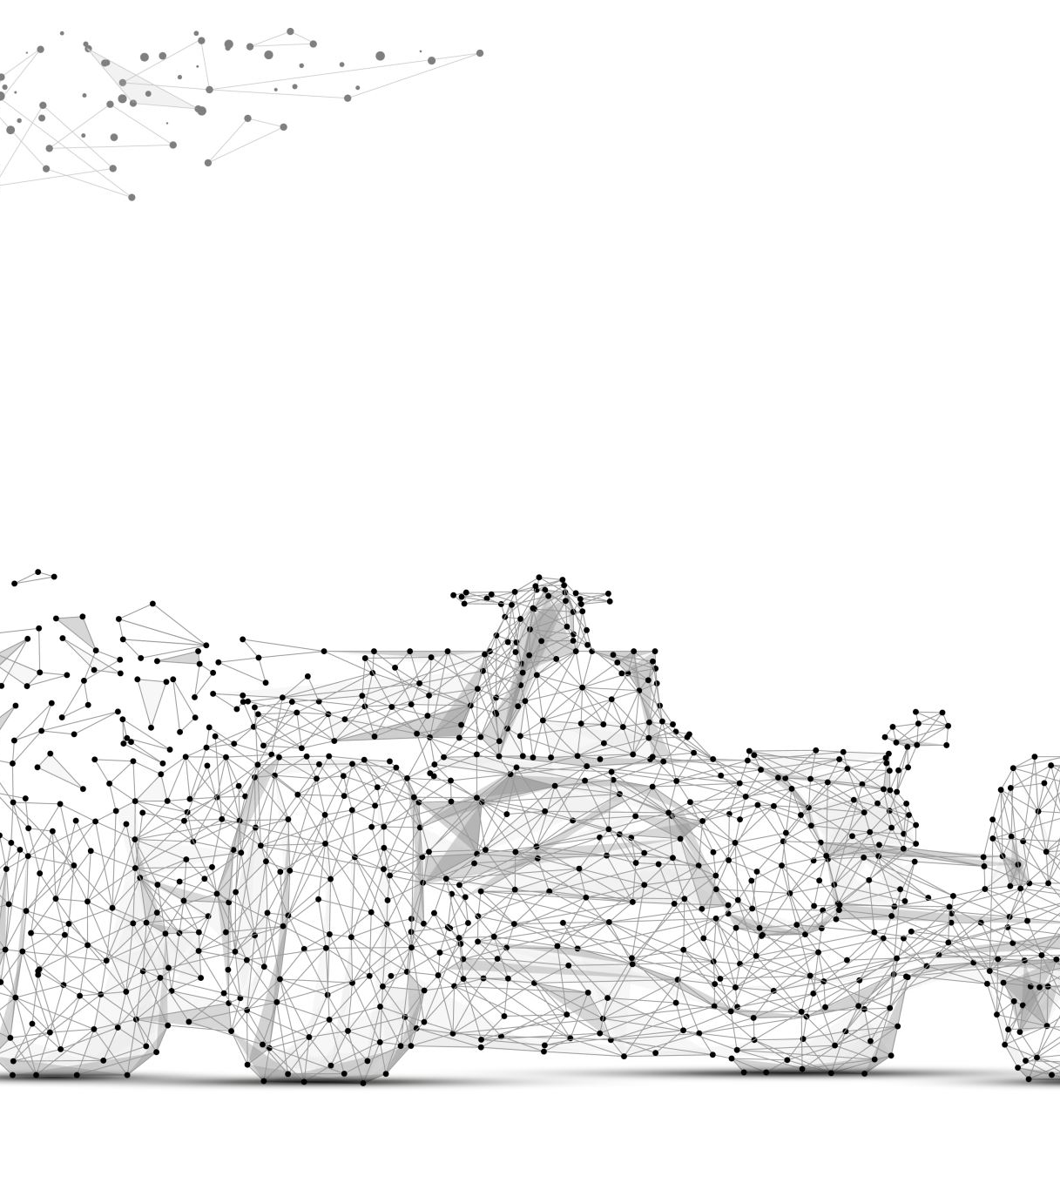
Use Cases in Business
Automate customer service with intelligent chatbots powered by Azure OpenAI.
Generate content for marketing, product descriptions, and internal documentation.
Analyze large datasets to gain insights and drive decision-making processes.
Notes:
Social Engineering involves tricking people into divulging information or performing actions that they normally wouldn't. It can take many forms, including phishing emails, pretexting, baiting, and more. Knowing what to look out for is key to avoiding Social Engineering attacks.

Slide 20

Improved Customer Experience
Use AI to enhance user interactions through personalized recommendations and support.
Streamline processes like resume screening or document summarization for HR departments.
Create engaging conversational agents that improve customer satisfaction.
Notes:
Social Engineering involves tricking people into divulging information or performing actions that they normally wouldn't. It can take many forms, including phishing emails, pretexting, baiting, and more. Knowing what to look out for is key to avoiding Social Engineering attacks.

Slide 21

Integration with Microsoft Ecosystem
Leverage existing Microsoft tools such as Power BI, Dynamics 365, and Teams.
Enhance productivity by integrating AI capabilities into familiar workflows.
Benefit from a unified platform that supports various business functions.
Notes:
Social Engineering involves tricking people into divulging information or performing actions that they normally wouldn't. It can take many forms, including phishing emails, pretexting, baiting, and more. Knowing what to look out for is key to avoiding Social Engineering attacks.

Slide 22

High Availability and Reliability
Hosted on Microsoft Azure's global infrastructure with over 60 regions available.
Built-in redundancy features ensure continuous service availability.
Robust disaster recovery options safeguard against data loss.
Notes:
Social Engineering involves tricking people into divulging information or performing actions that they normally wouldn't. It can take many forms, including phishing emails, pretexting, baiting, and more. Knowing what to look out for is key to avoiding Social Engineering attacks.

Slide 23

Training AI Models Efficiently
Azure provides the necessary computing power for training complex AI models.
Access to vast datasets enhances the quality of trained models.
Accelerates the development cycle from ideation to deployment.
Notes:
Social Engineering involves tricking people into divulging information or performing actions that they normally wouldn't. It can take many forms, including phishing emails, pretexting, baiting, and more. Knowing what to look out for is key to avoiding Social Engineering attacks.

Slide 24

Community Support and Resources
Extensive documentation, tutorials, and code samples available for developers.
Active community forums provide a platform for sharing experiences and solutions.
Continuous updates ensure users stay informed about new features and best practices.
Notes:
Social Engineering involves tricking people into divulging information or performing actions that they normally wouldn't. It can take many forms, including phishing emails, pretexting, baiting, and more. Knowing what to look out for is key to avoiding Social Engineering attacks.

Slide 25

Future-Proofing Your Business
Stay competitive by adopting cutting-edge AI technologies through Azure OpenAI.
Adapt quickly to changing market demands with scalable AI solutions.
Foster innovation by integrating AI into core business processes.
Notes:
Social Engineering involves tricking people into divulging information or performing actions that they normally wouldn't. It can take many forms, including phishing emails, pretexting, baiting, and more. Knowing what to look out for is key to avoiding Social Engineering attacks.

Slide 26

Challenges of Implementation
Initial learning curve for teams unfamiliar with AI technologies.
Ensuring data privacy while utilizing third-party AI services can be complex.
Ongoing maintenance and updates required to keep models effective.
Notes:
Social Engineering attacks can use a wide range of techniques to manipulate people. These include impersonation, creating a sense of urgency, using fear or intimidation, and more. By understanding these techniques, you can better protect yourself against Social Engineering attacks.

Slide 27

Real-Life Success Stories
Companies like CarMax use Azure OpenAI to streamline content creation processes significantly.
TomTom leverages AI for immersive in-car infotainment systems, enhancing user experience.
Fraport integrates chatbots to assist employees in operational tasks efficiently.
Notes:
Social Engineering attacks can have serious consequences for both individuals and organizations. These include financial losses, identity theft, damage to reputation, and more. By being aware of the risks, you can take steps to protect yourself and your organization.

Slide 28
Getting Started with Azure OpenAI
Define your business objectives and identify potential use cases for AI integration.
Apply for access to Azure OpenAI Service through Microsoft’s official channels.
Begin experimenting with pre-trained models or develop custom solutions tailored to your needs.
Notes:
Defending against Social Engineering attacks requires a combination of awareness and technology. In this section, we will explore some best practices for securing personal information, and discuss the importance of effective security awareness training.

Slide 29
Training Resources Available
Explore Microsoft Learn for comprehensive training modules on Azure OpenAI Service.
Participate in community challenges or hackathons focused on AI development.
Utilize online courses that cover best practices in implementing AI solutions.
Notes:
Defending against Social Engineering attacks requires a combination of awareness and technology. In this section, we will explore some best practices for securing personal information, and discuss the importance of effective security awareness training.

Slide 30
Conclusion
Azure OpenAI offers a powerful platform for businesses looking to harness the potential of AI technology.
Combining scalability, security, and integration capabilities makes it an attractive option for enterprises of all sizes.
Embrace the future of AI by leveraging Azure OpenAI solutions tailored to your business needs.
Notes:
Defending against Social Engineering attacks requires a combination of awareness and technology. In this section, we will explore some best practices for securing personal information, and discuss the importance of effective security awareness training.

Slide 31

Email: info@zalnet.pl ​
Twitter: beatazalewa​
Github: beatazalewa​
LinkedIn: beatazalewa
Blog: beatazalewa.com
Notes:
Description of Resource 14

Slide 32

Bibliography
https://startups.microsoft.com/blog/8-steps-to-building-an-azure-openai-copilot-for-your-startup/
https://www.dev4side.com/en/blog/azure-openai-service
https://forwardforever.com/building-smarter-copilots-with-copilot-studio-and-azure-openai-integration/
https://azure.microsoft.com/en-us/blog/azure-openai-service-powers-the-microsoft-copilot-ecosystem/
Notes:
Description of Resource 12

